Slide 1

The following presentation is © 2016 Canadian Centre for Child Protection Inc., except for a third party video that is the property of its respective owner (see last slide). All rights reserved.
The presentation is intended to be delivered by a member of a Canadian policing agency or a teacher at a Canadian school to students in grade 9 and 10, and it is intended for use with “Addressing Sexual Violence and Online Risks Facing Youth in Grades 9 and 10” and “It is a Big Deal”. The information in this presentation is provided for educational purposes only. It is not intended as legal advice and should not be relied upon as such.
The presentation has been licensed under terms and conditions which include an exclusion of liability, along with the following restrictions:
  NO MODIFICATION of this presentation is permitted.
  NO ONLINE POSTING of this presentation is permitted.
  NO DISTRIBUTION of this presentation is permitted, except pursuant to the license terms.
License terms were supplied prior to the licensee accessing the presentations. If you require a copy of such terms, please email license@protectchildren.ca.

Slide 2


Slide 3
Today we are going to talk about:
technology
relationships
sexual consent
You will understand what is considered a BIG deal and how to stay safe.

Slide 4
True or False
Take a few moments to complete the
True or False Questionnaire.

Slide 5

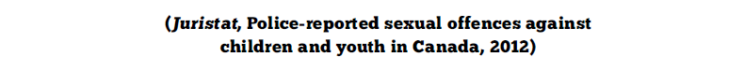

Slide 6
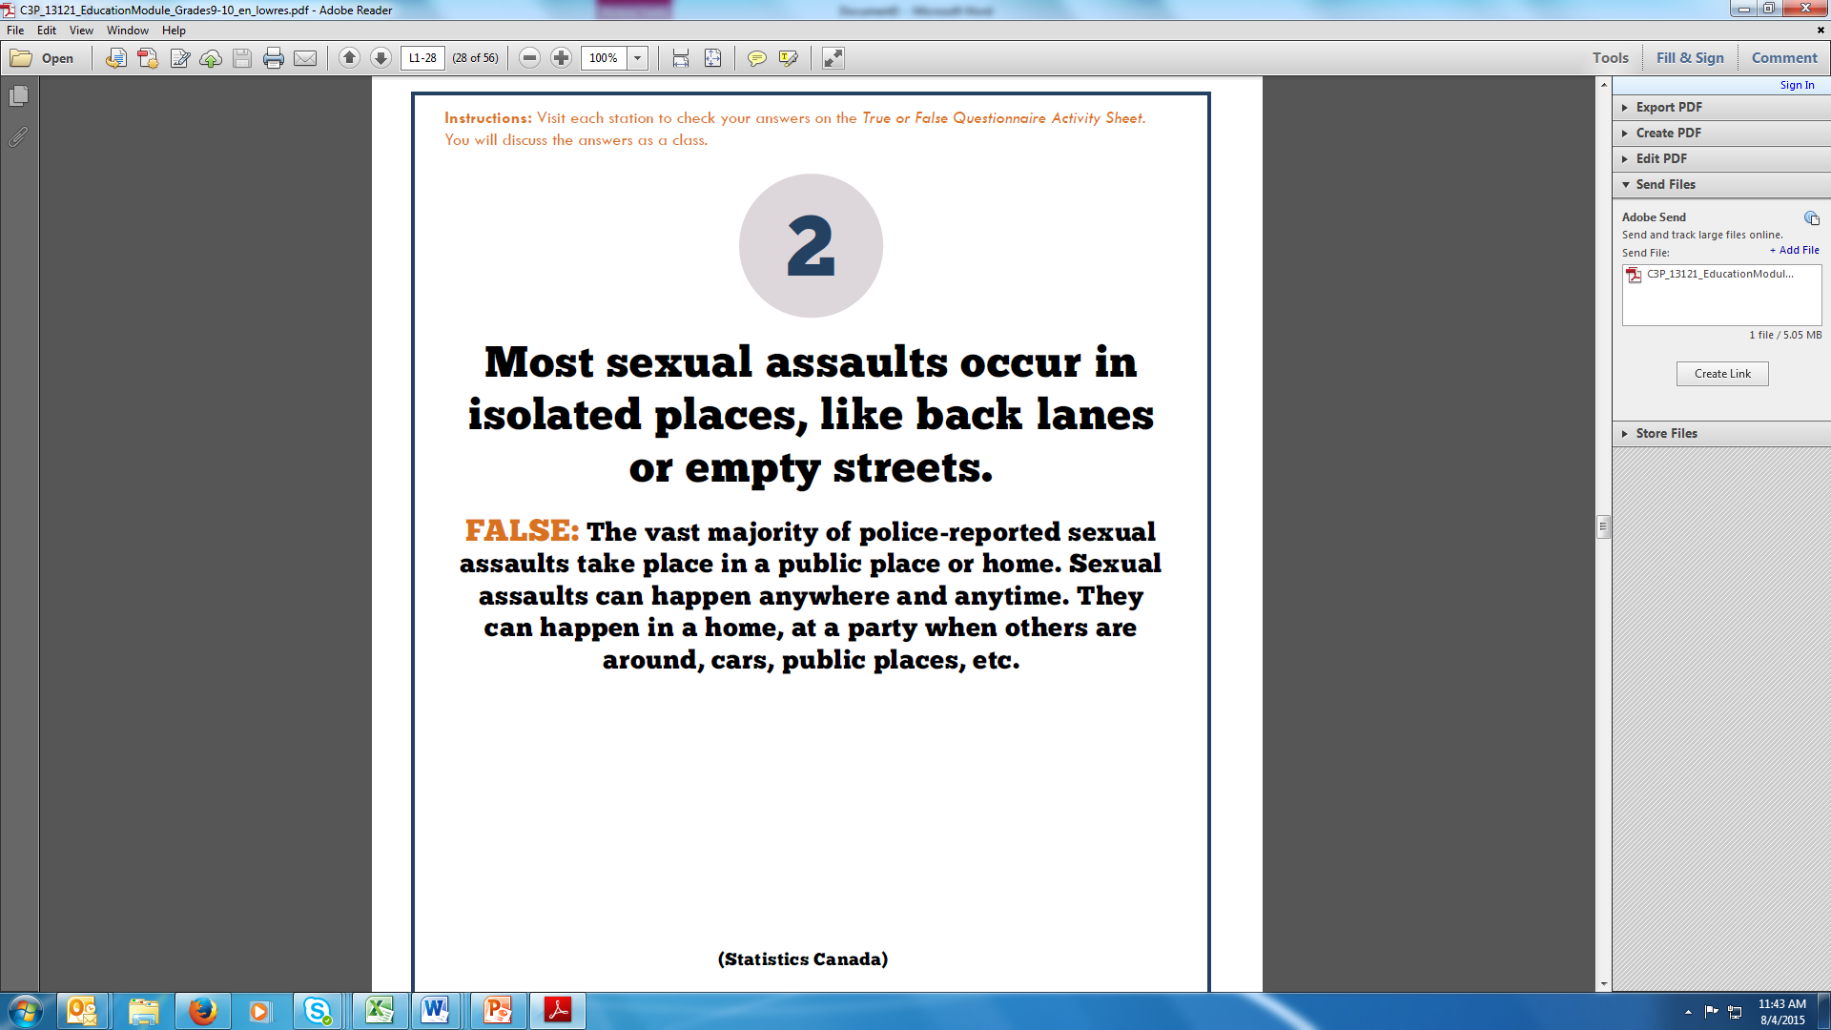

Slide 7
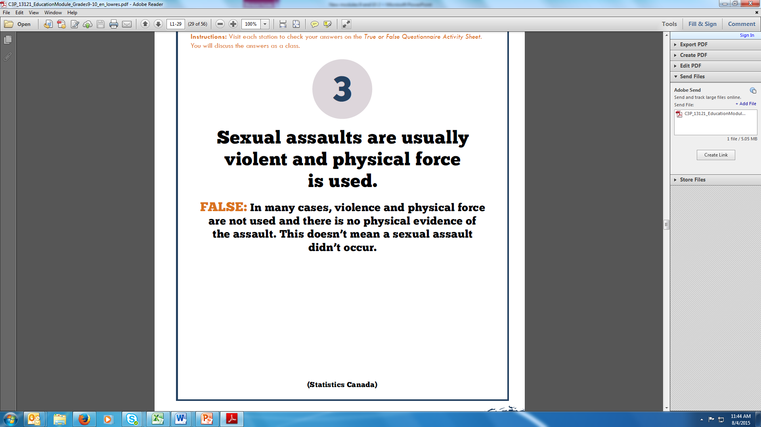

Slide 8
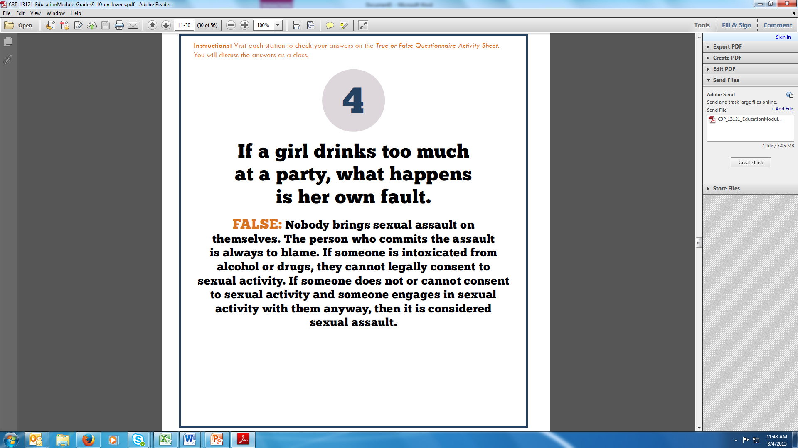

Slide 9
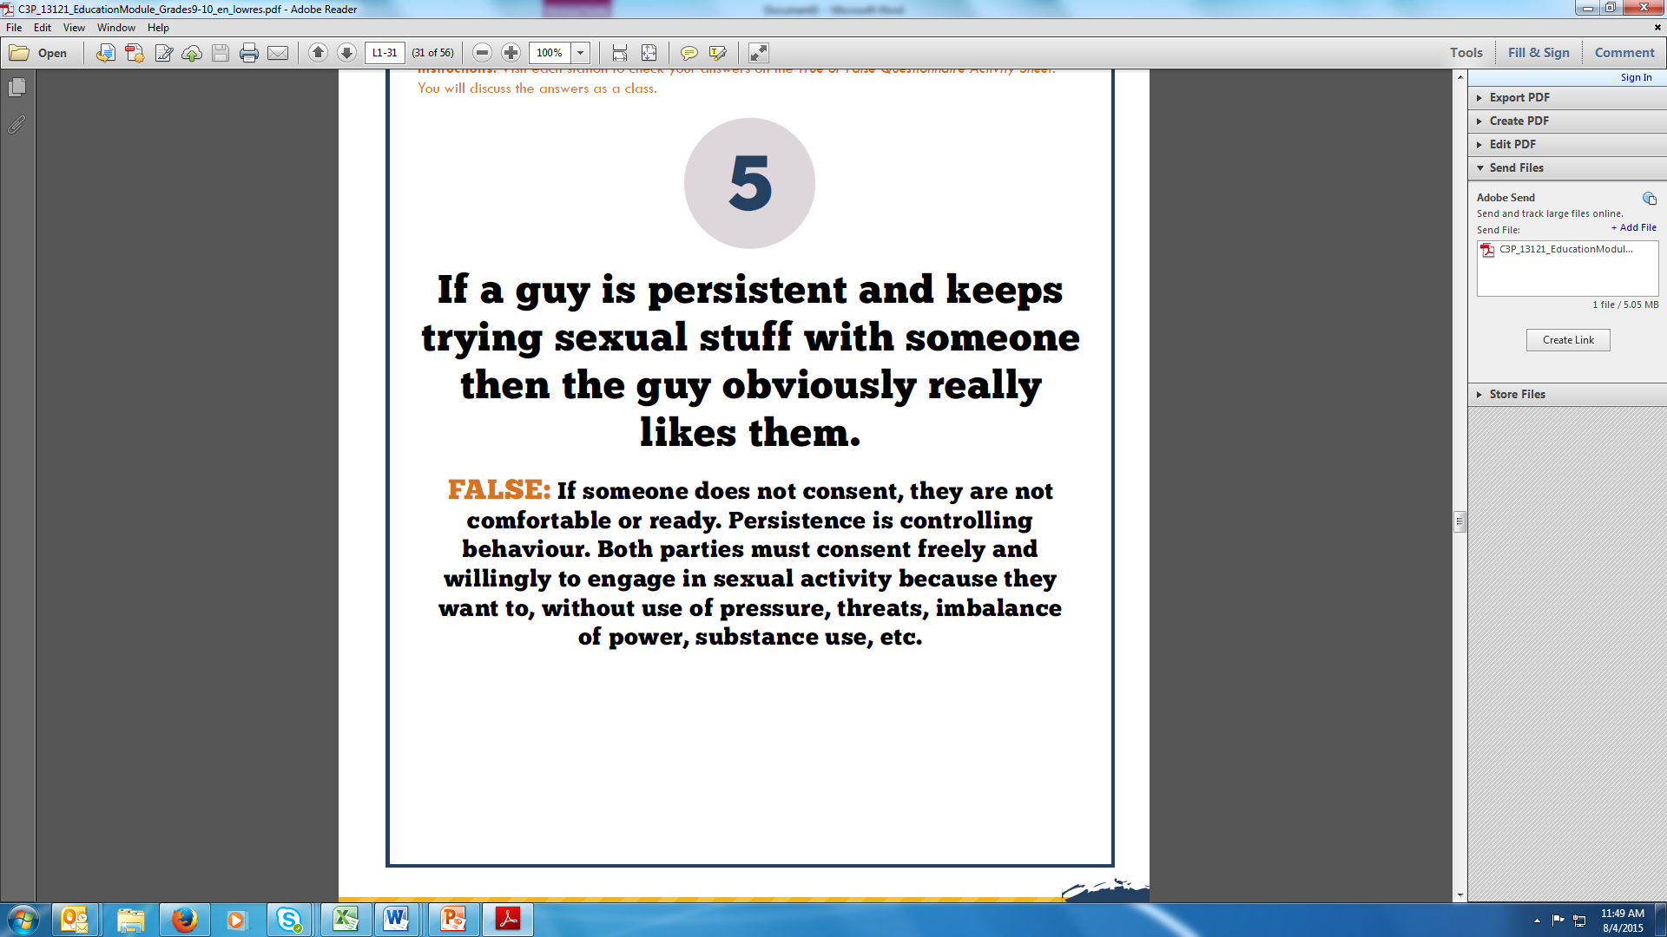

Slide 10
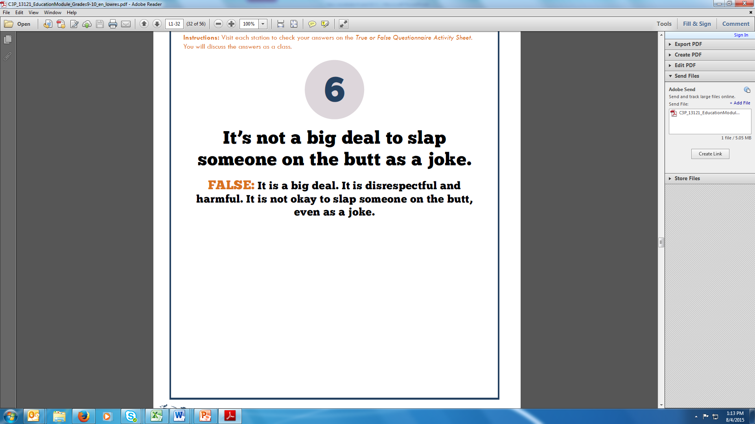

Slide 11
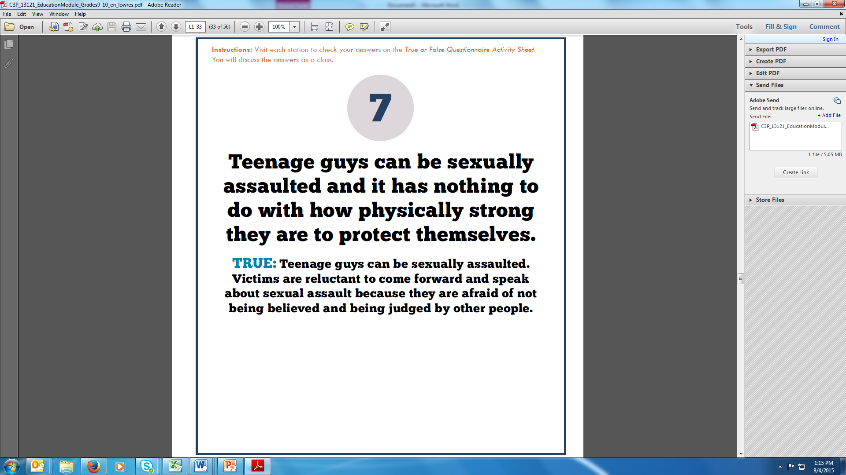

Slide 12
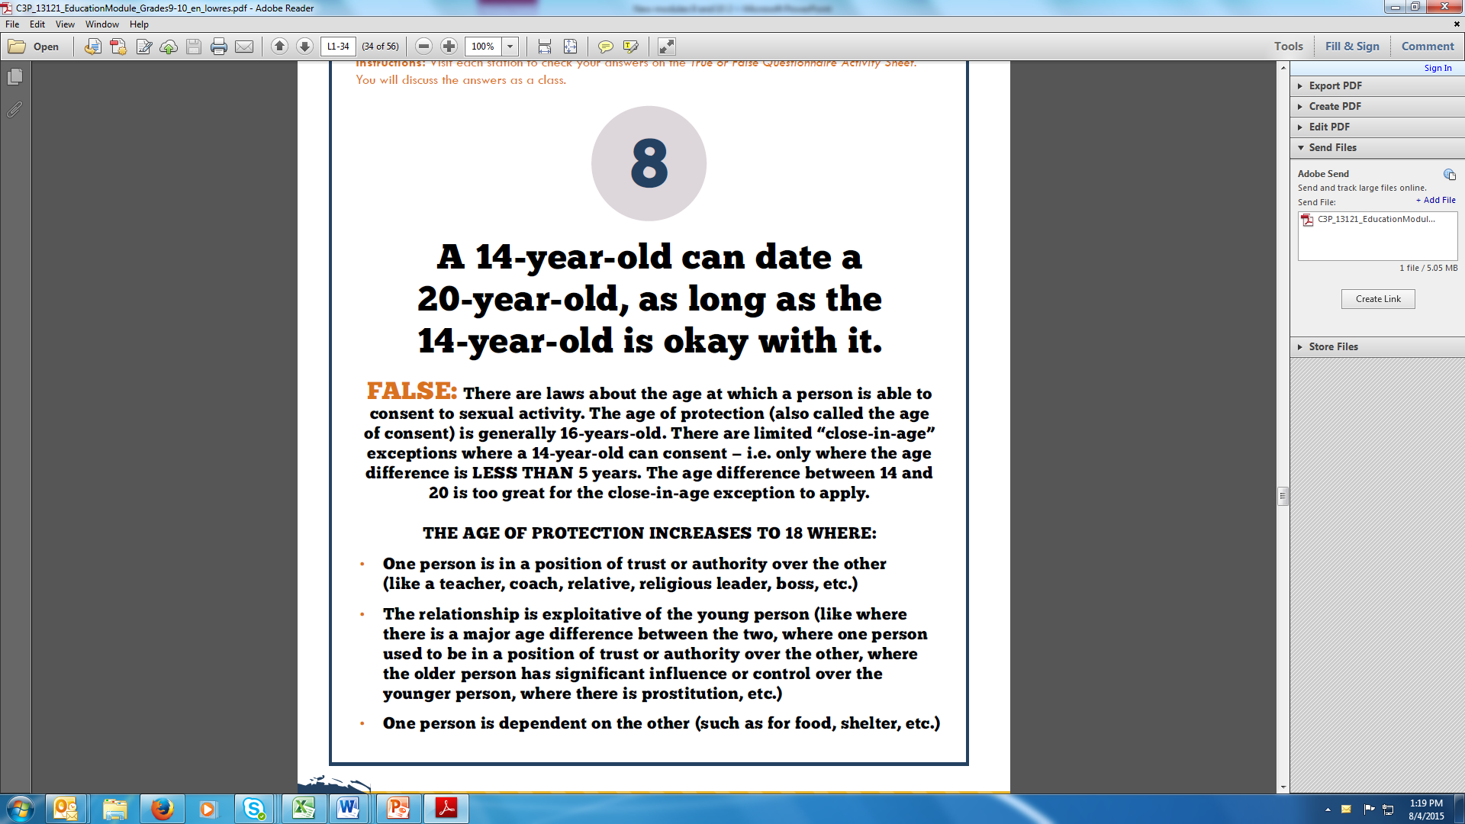

Slide 13
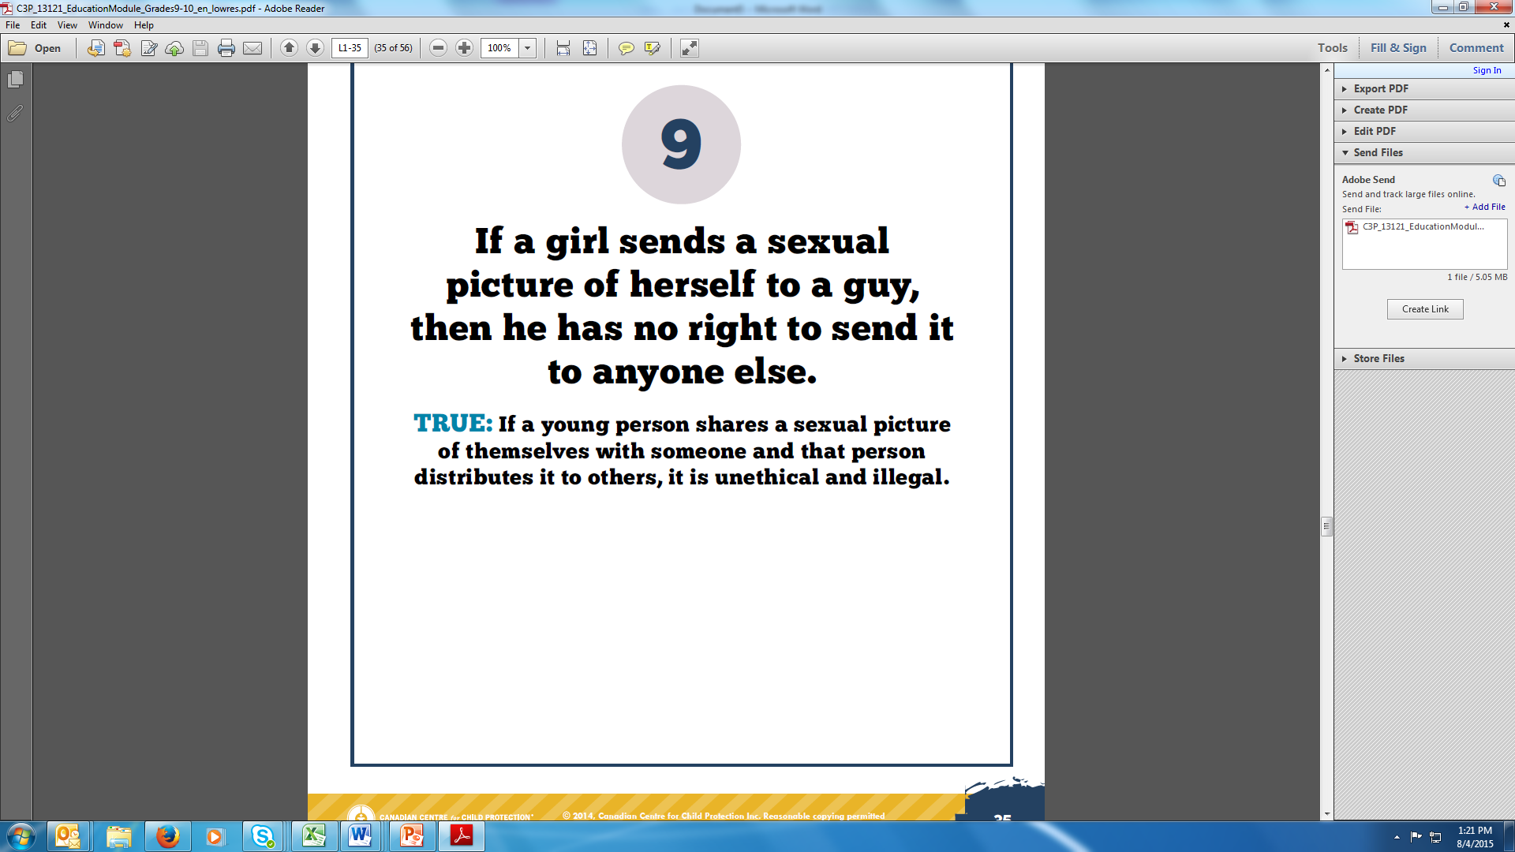

Slide 14
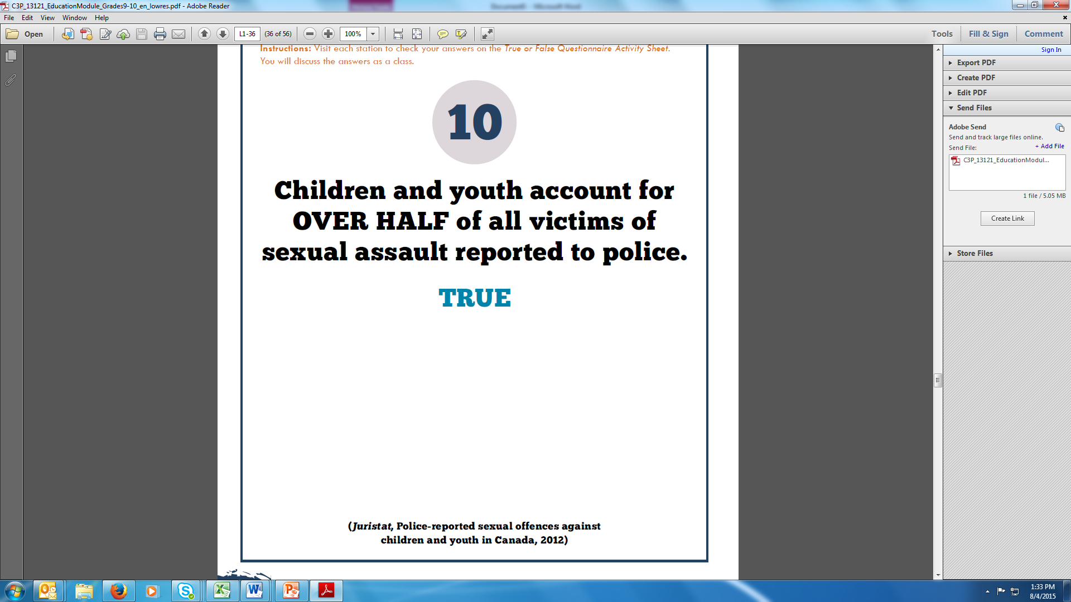

Slide 15
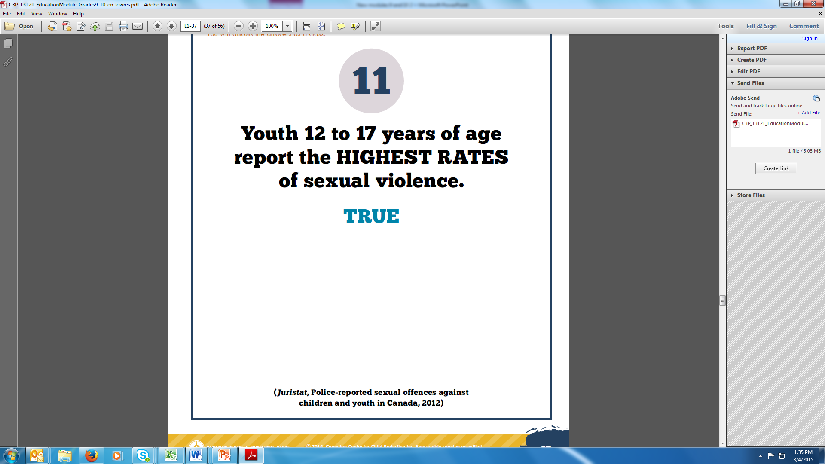

Slide 16
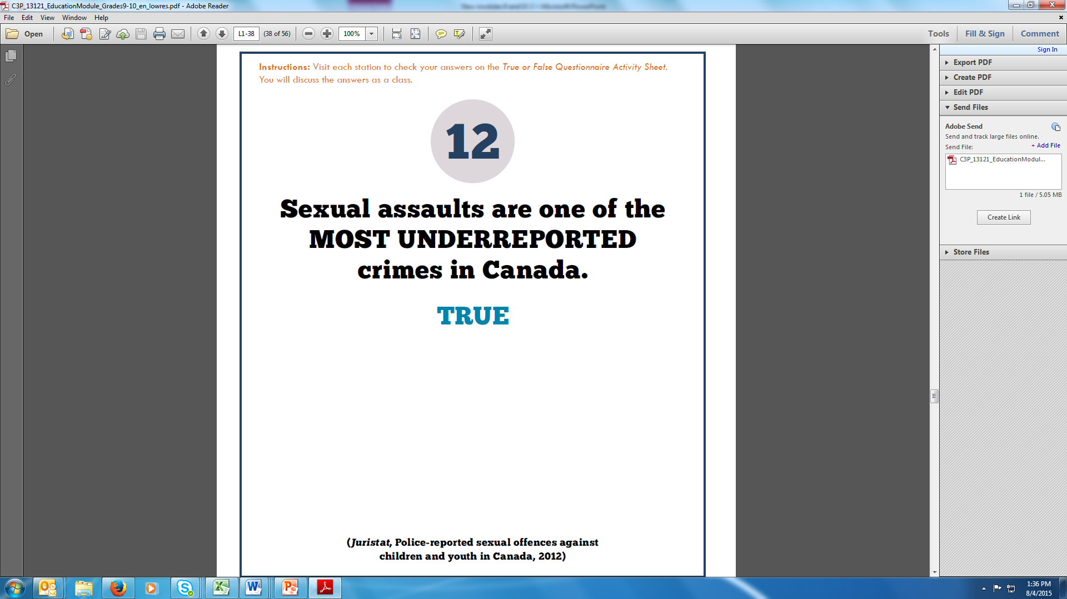

Slide 17
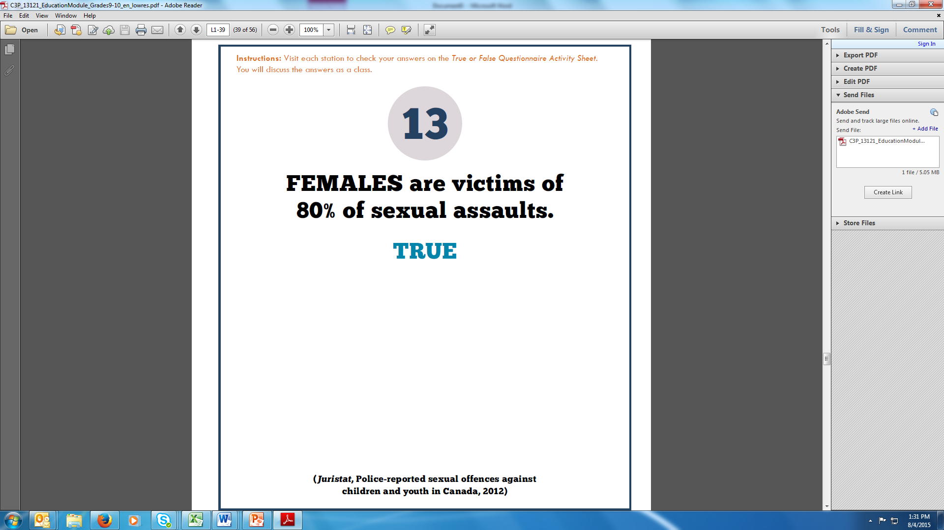

Slide 18
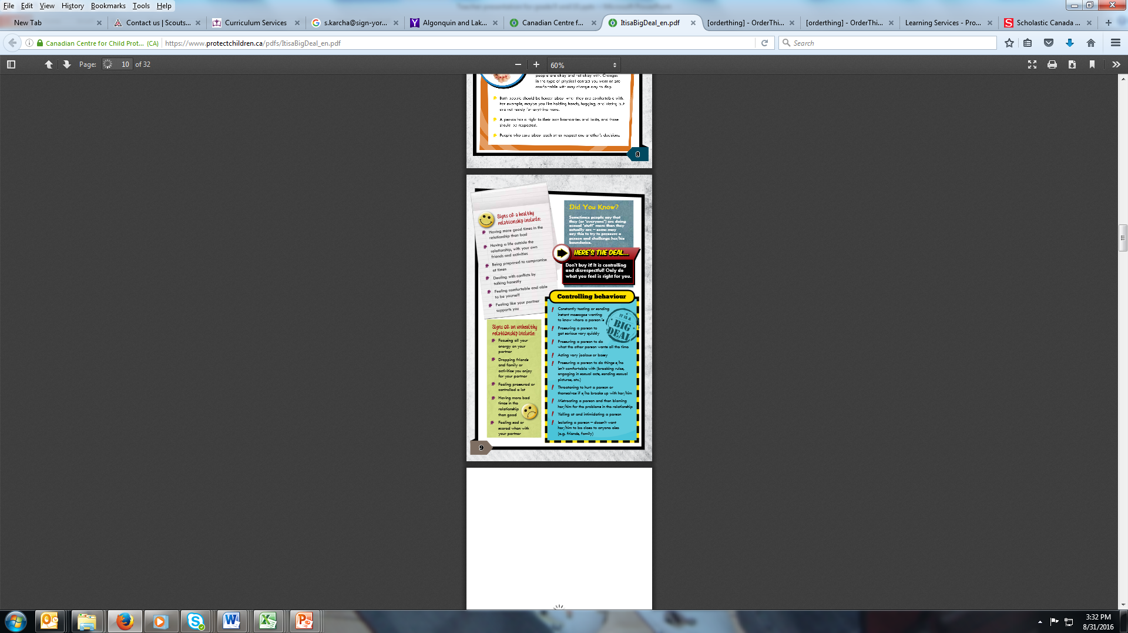
Love vs. Control
Pages 8 and 9 of the Activity Book.
Why do you think that youth may sometimes mistake controlling behaviours for love?

Slide 19
Age of Sexual Consent
The Age of Sexual Consent (also know as the Age of Protection) is in place to protect young people from being sexually exploited or abused by adults. It refers to the age that a person can legally consent to sexual activity.
The age of consent is generally 16-years-old. The table on the following slide sets out the age at which consent can be given, based on the age of the child and the other person.

Slide 20
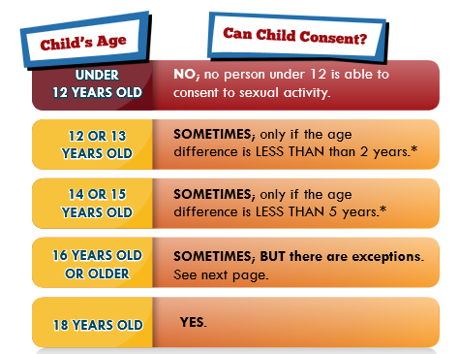
Page 15 of the Activity Book
*The close-in-age exception will not apply where: the other person is in a position of trust of the authority over the children; the child is dependent on the other person; or the relationship is exploitative – just like the exceptions to consent for the persons 16 years and over. In these situations, a person must be 18 years old to consent.

Slide 21
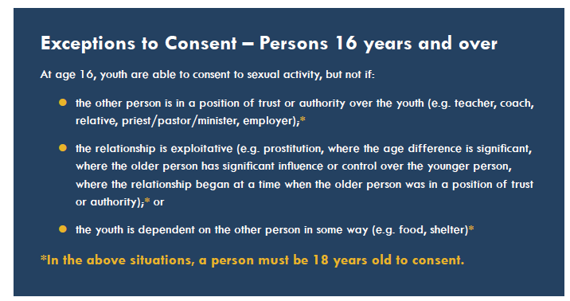
Page 16 of the Activity Book

Slide 22
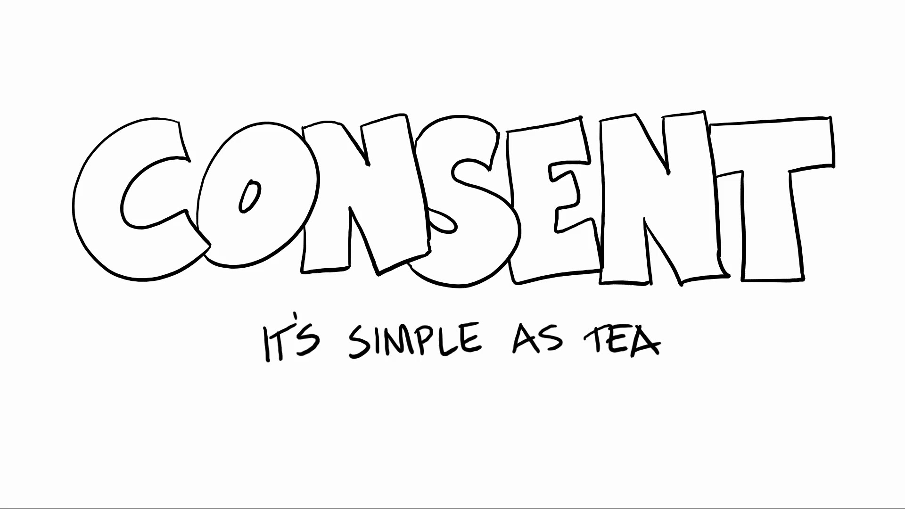
©2015 Emmeline May and Blue Seat Studios. https://www.youtube.com/watch?v=fGoWLWS4-kU

Slide 23
STORY
Where Did Everyone Go?
Before reading – Predict from title what the story will be about.
Read the story aloud and stop where indicated.
During reading – write down the names of all the characters and any notes about their role in the story as you read.
After reading – What should Chelsea do next?
Read the ending – Using the character cards, line up in order of who could have helped at what point in the story.
Ask who should be held most responsible for what happened to Chelsea?

Slide 24
The Law – it is a BIG deal!
Pages 24-26 of the Activity Book
In Canada, there are criminal offences that cover the
following:
  Unwanted or illegal sexual contact
  Acts that make others feel unsafe
  Acts that hurt the reputation of another person
  Acts that violate privacy
  Illegal pictures and videos

Slide 25
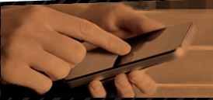
Sexting Discussion
1 in 5 youth consented to sexting when they didn’t want to.
Article: Computers in Human Behaviour
Sexting: A new, digital vehicle for intimate partner aggression
Michelle Drouin, Jody Ross, Elizabeth Tobin
Sexting has become a common part of relationships.
What are the risks of sending a sexual picture?
Page 12 of the Activity Book

Slide 26

It’s YOUR Story to Tell

Slide 27
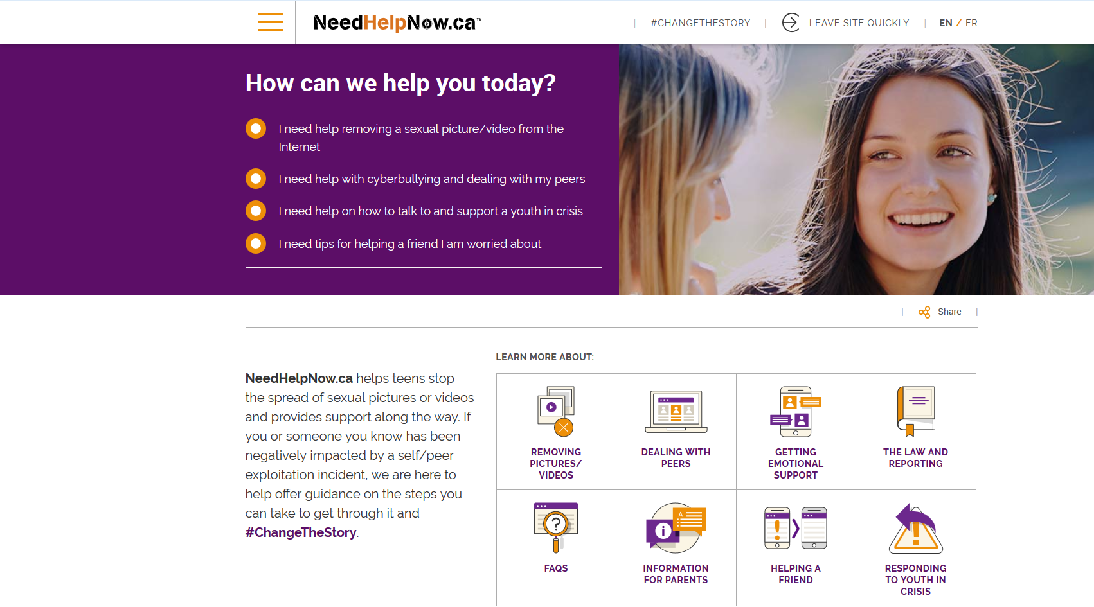
NeedHelpNow.ca
NeedHelpNow.ca helps teens stop the spread of sexual pictures or videos and provides support along the way. If you or someone you know has been negatively impacted by a self/peer exploitation incident, NeedHelpNow.ca is here to help offer guidance on the steps you can take to get through it and #ChangeTheStory.

Slide 28
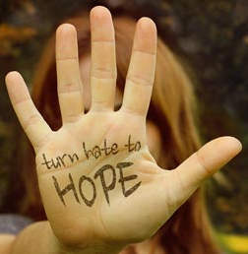
Visit NeedHelpNow.ca to learn about steps you can take to get nude pictures off the Internet.
Tips for supporting the person who is going through the difficult time:
Send them a message to see if they are okay
Refuse to participate and remove yourself from the situation
Do not ‘like’ or forward nude images
Speak to an adult who can help
Report your concerns to Cybertip.ca

Slide 29
Seeking Support
Family members or another safe adult (such as a teacher, school guidance counsellor, or school resource officer)
If unable to identify a safe adult to talk to, contact a crisis line, like Kids Help Phone (1-800-668-6868)
Cybertip.ca either online www.cybertip.ca or call 1-866-658-9022 if something inappropriate or uncomfortable happens online.
Visit www.needhelpnow.ca if you need help gaining control of a sexual image circulating online.

Slide 30
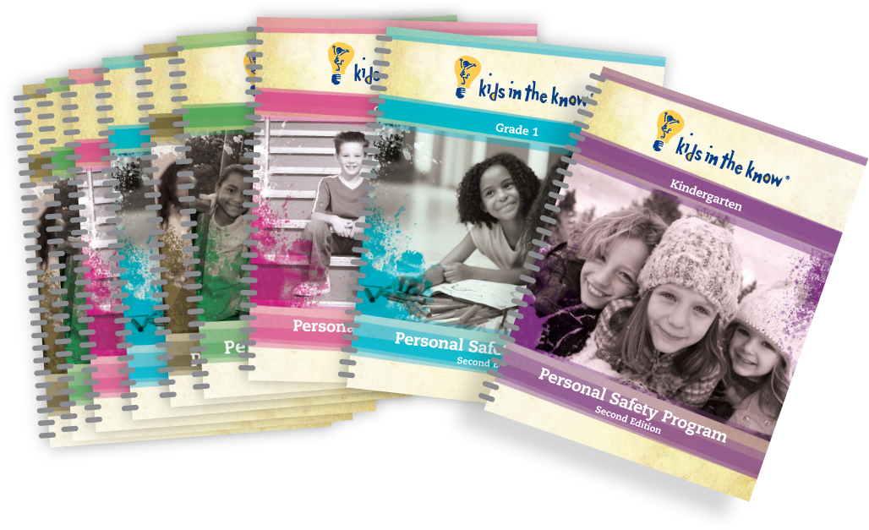
It is a BIG deal
is part of the Kids in the Know program.

Slide 31
This presentation is owned by the Canadian Centre for Child Protection Inc. (“C3P”) and must be licensed. For license details, please email license@protectchildren.ca.
Third Party Content Credits
  All stock photos are used under license from Thinkstock.
  The “Consent: It’s Simple as Tea” video is owned by Emmeline May and Blue Seat Studios. This non-commercial use of the video is accordance with the terms on https://vimeo.com/126553913.
Trademarks
“CANADIAN CENTRE for CHILD PROTECTION” and “Kids in the Know” are registered in Canada as a trademarks of; and “It is a Big Deal” is used in Canada as a trademark of; the Canadian Centre for Child Protection Inc.

